Slide 1
ECID vs Device ID
Bill Eklow
Cisco

Slide 2
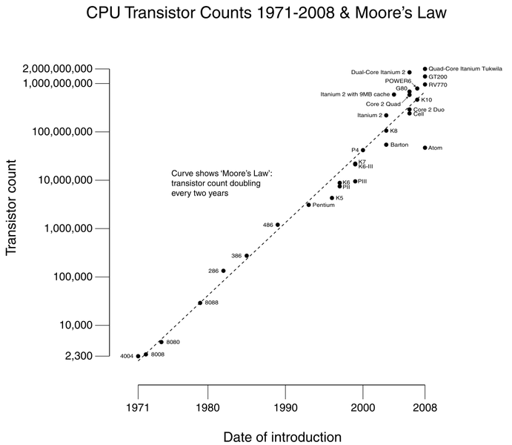
Moore’s Law – Transistor Count

Slide 3
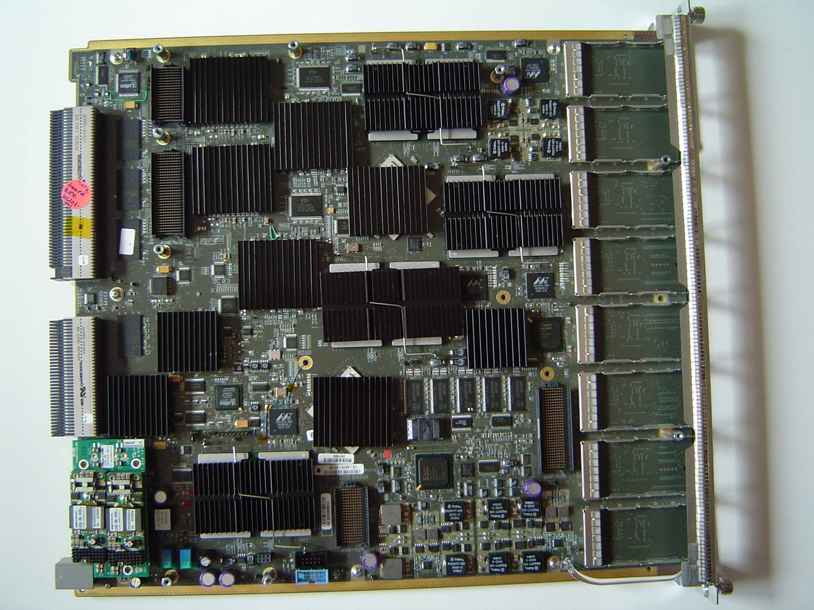
Board Level Complexity

Slide 4
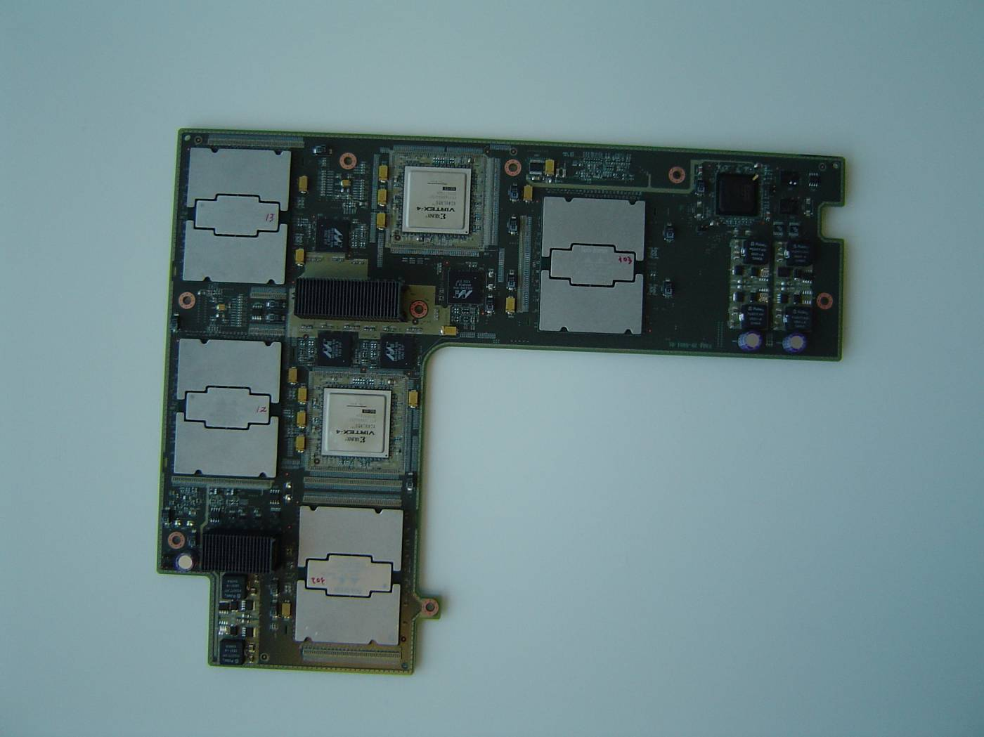
Moore Complexity

Slide 5
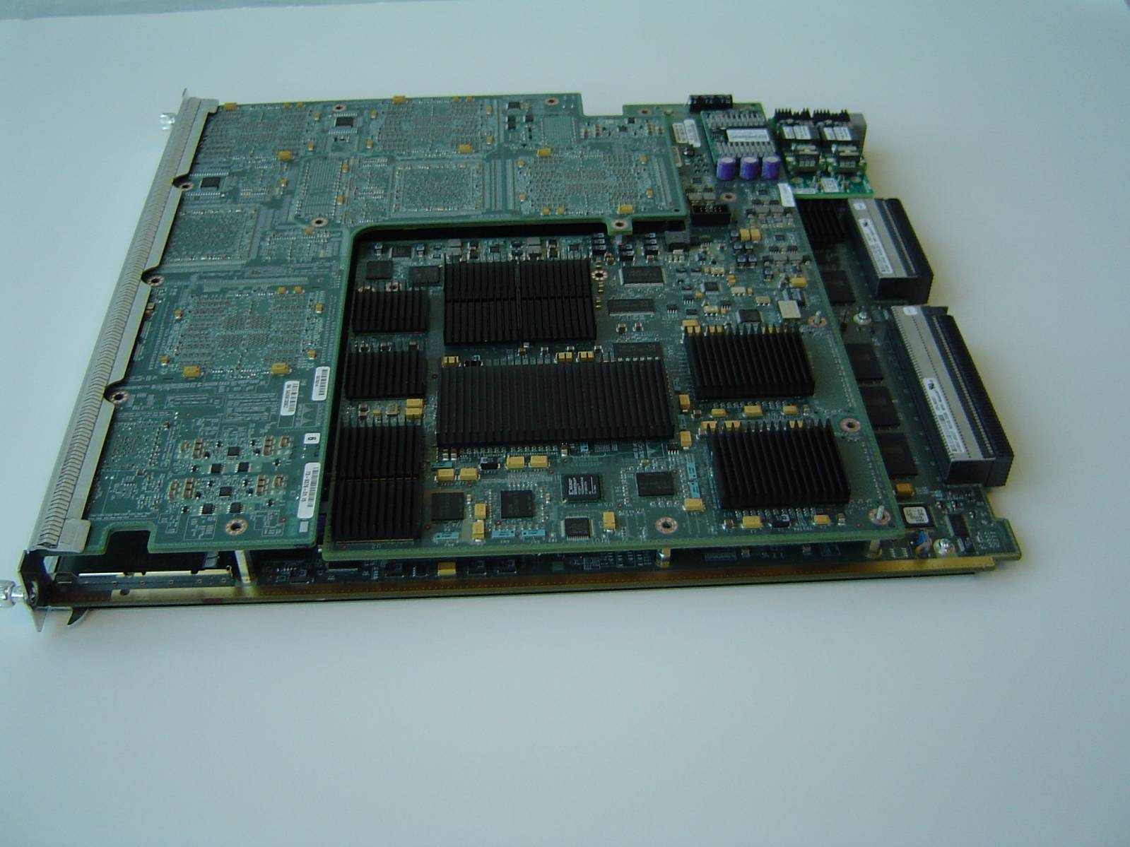
Combined Line Card
Chips@Cisco 2005
© 2005 Cisco Systems, Inc. All rights reserved.

Slide 6
Why Chips Fail in System

Slide 7
Returning Bad Components
board fails
functional test
Re-verified
at debug
Confirmed
BScan
Pass
Remove failed ASIC
and replace it
ICT retest *
Pass
X-ray retest
Pass
Confirmed
ASIC fail to
Supplier for retest
X-ray retest
Pass
Pass
Board to
production
ICT retest
Notes:
Volume process driven effort
Assure high probability of part capture
and FA execution
Engineering driven effort
Assuring high probability of real Device/Silicon issues
Allowing full Engineering focus of supplier

Slide 8
Root Causing Bad Components
Focused ASIC RMA
Supplier
coverage ok?
no
Add more
coverage
yes
Supplier retest
fail
Supplier FA
pass = NTF
Retest NTFs
in system
fail
Diagnose fail
pass
Test escape? Environmental fail?
Bad Diags? Good ASIC?
ATE Test escape?
Notes:
DPMO made up of ASIC fails, board level defects, diag inaccuracies,
so what is validated (components) vs invalidated (other fails and should be 0 – how are we cleaning this up btw)?
Bill: add timing screen (at-speed) may be in context of analyzing ASIC DFT/test
Also add system FA after retest – need data available too – vs CMs/boards/location on board
Suppliers add problem…..

Slide 9
Please – No More Moore!!!!
Device complexity/gate count/speed increasing
Component volumes increasing
Product Diversity increasing
Disconnect between Manufacturing and Engineering
Disconnect between CMs and Component Suppliers
Field Failures???
Result: Systemic Component Problems rarely get fixed

Slide 10
Collaboration in a Virtual Supply Chain
Component Suppliers
EMS Partners
Quality Data Infrastructure
System Integrator
Customer
Notes:
Goal: Establish “single version of truth” data
Project began 3 years ago
Partners: Internally: GSCM, CDO, Corp Quality, IT Externally: Suppliers, Customers
360-degree view of quality data collected daily from multiple sources at multiple locations
Provides ability to co-relate data from different sources; transform into actionable intelligence
Provides central backbone platform for internal and external quality reviews

Slide 11
What is eCID?
eCID is acronym for, “electronic chip ID”
Initiated by IBM
Now a requirement for all new ASICs
Accessible via JTAG or CPU
In IBM case, 112 bit string contains the following information
Lot ID
Wafer ID
X / Y location of die in a wafer
w1234
For example,
eCID = {lot xyz, w1234, 4, 2}

Slide 12
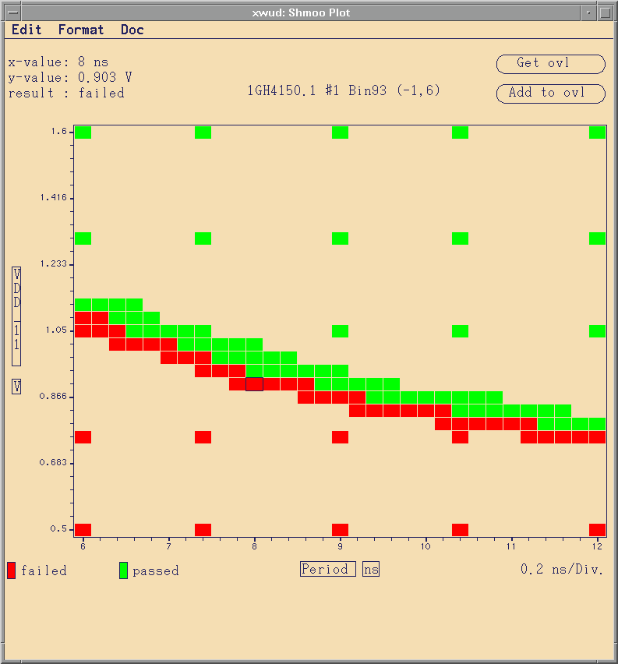
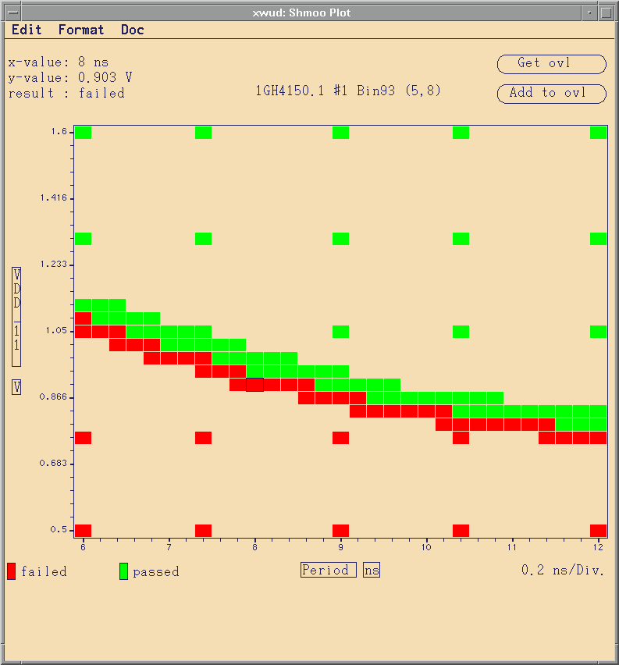
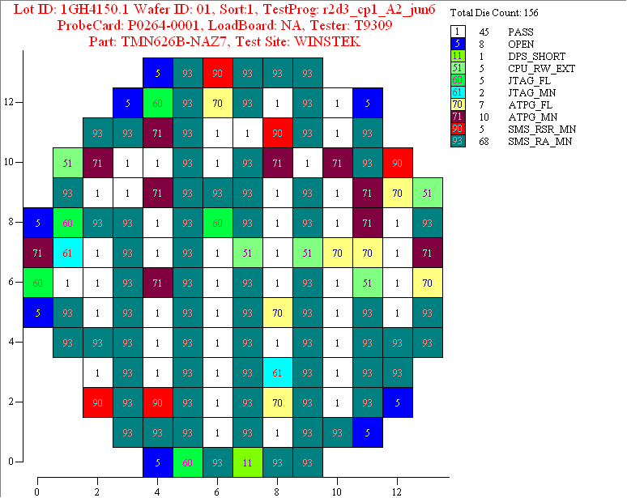
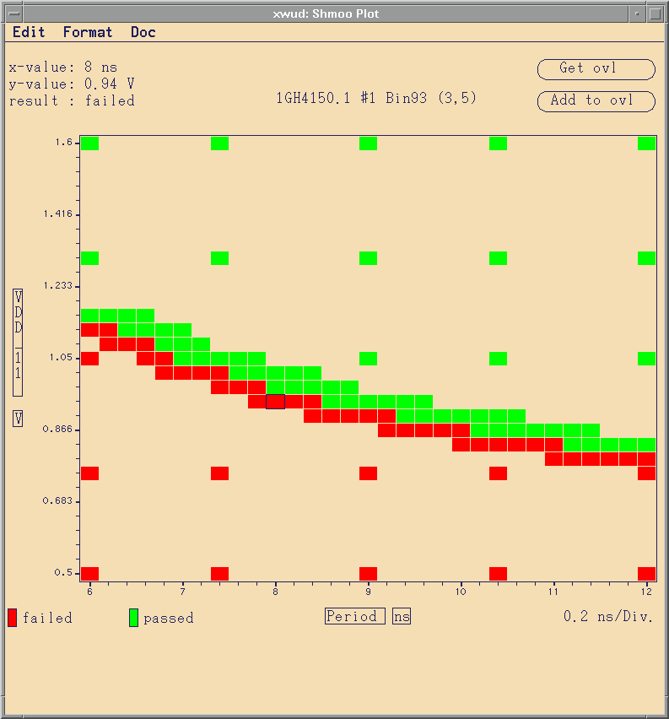
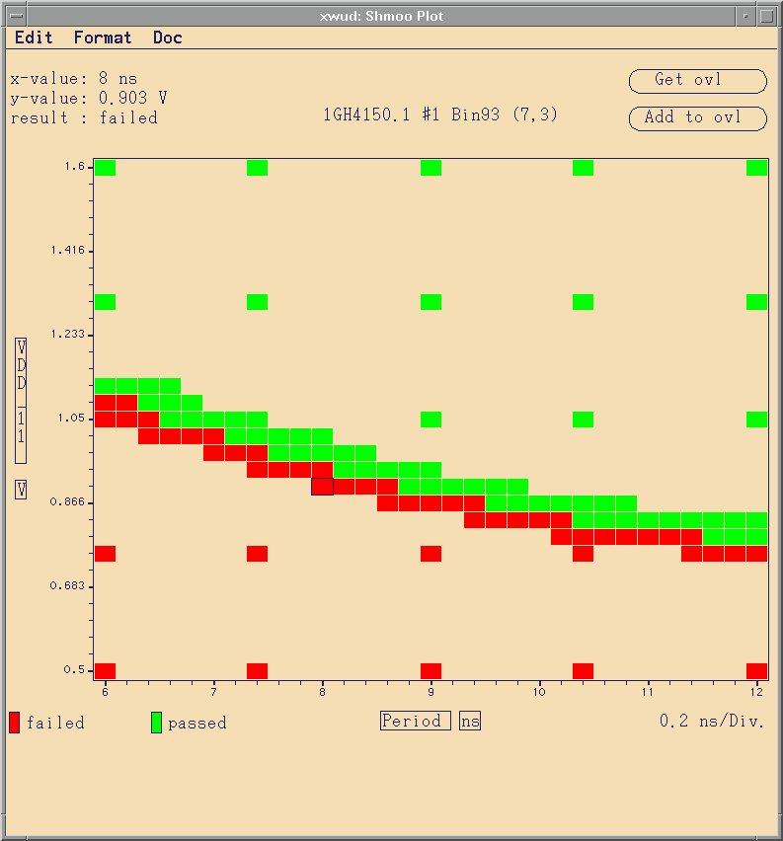
Wafer Map Analysis : feedback mech.
Pass
“Good”
Neighbors
Voltage
Freq
“Bad”
Neighbors
+ Edge die
Margin
Variation

Slide 13
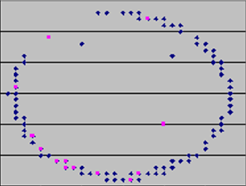
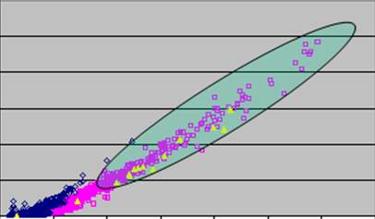
End-to-End Process Data
Key Analysis Tools
ECID regionality analysis
Parametric characterization data for anomalies
0
5
10
15
20
25
30
Actions Taken
Tightened test limits reducing product failures

Slide 14
Benefits
Component Suppliers get data, not parts
Can apply component yield methodologies to system failures (Virtual Vertical Integration)
Process automation
Much finer granularity for traceability

Slide 15
Issues
Standardizing access and format of ECID data
Device ID???

Slide 16
Device ID

Slide 17
Challenges
Full ICT may go away
Functional diagnostics
Hard to scale
Need pilot project to test out
Need IT support
Escalate the priority
Current pilot
Not running for all ASIC/CM/Supplier

